Slide 1

6th Grade Accelerated Math
Unit 11, Lesson 1 Adding Rational Numbers Volume 2, pg. 165

Slide 2


Benchmark
MA.7.NSO.2.2
Add, subtract, multiply, and divide rational numbers with procedural fluency.
volume 2, pg. 165

Slide 3
Integrated Mathematical Thinking and Reasoning Standards
MA.K12.MTR.1.1 Actively participate in effortful learning both individually and collectively.
MA.K12.MTR.2.1 Demonstrate understanding by representing problems in multiple ways.
MA.K12.MTR.3.1 Complete tasks with mathematical fluency.
MA.K12.MTR.4.1 Engage in discussions that reflect on the mathematical thinking of self and others.
MA.K12.MTR.5.1 Use patterns and structure to help understand and connect mathematical concepts.
volume 2, pg. 165

Slide 4

Learning Target
I can fluently add rational numbers.
volume 2, pg. 165

Slide 5

Warm-Up
volume 2, pg. 165

Slide 6
11.1.1 Warm-Up: Landscape Architect
Janice Nicol, a landscape architect, works to design natural systems and outdoor spaces, like trails and parks, for campuses and recreational facilities. Her job is both creative and technical. Creativity is expressed through drawing sketches both by hand and by using computer design programs and imaging. The technical side of her job involves knowing things such as land grading, water calculations, and natural systems.
Janice mentions that she regularly collaborates and works together with others while doing her job.
volume 2, pg. 165

Slide 7
Why do you think it is important to be able to collaborate when doing a job?
How can you build your collaboration skills?
volume 2, pg. 165

Slide 8

Guided Instruction
volume 2, pg. 166

Slide 9
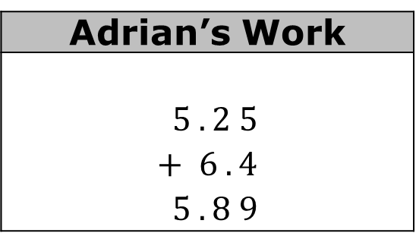

11.1.2 Guided Instruction: Adding Positive Rational Numbers
Adrian added $5.25$ and $6.4$. His work is shown.
Write an explanation to Adrian detailing any mistakes he made and how he can correct his work.
Adrian’s Work
$$5 . 2 5$$ $$+ 6 . 4$$ $$5 . 8 9$$
volume 2, pg. 166

Slide 10

What is the sum of $5.25$ and $6.4$?
When finding the sum of decimal numbers, add values with the same place value.
volume 2, pg. 166

Slide 11
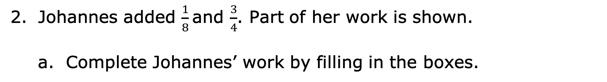
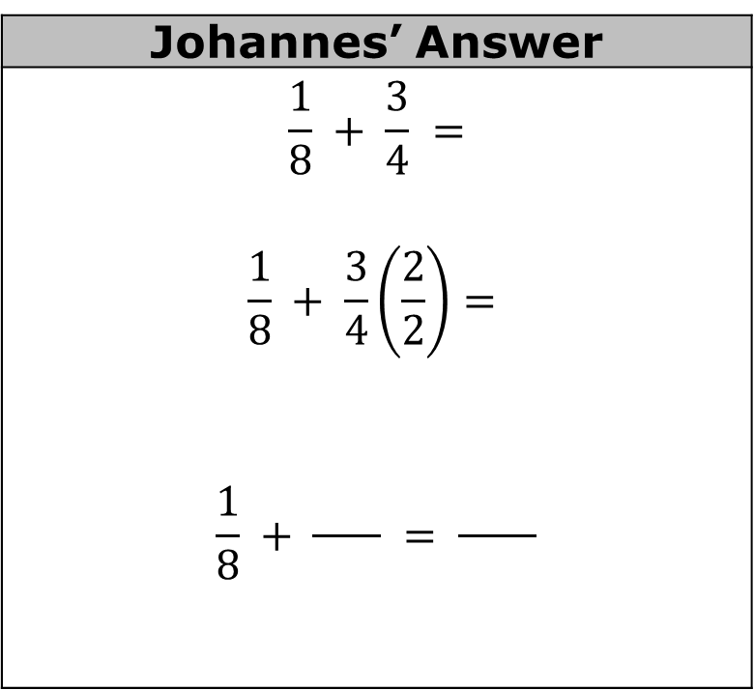
Johannes added $\frac{1}{8}$and $\frac{3}{4}$. Part of her work is shown.
Complete Johannes’ work by filling in the boxes.
Johannes’ Answer
$$\frac{1}{8} + \frac{3}{4} =$$ $$\frac{1}{8} + \frac{3}{4}\left(\frac{2}{2}\right)=$$ $$\frac{1}{8} + \frac{ }{ } = \frac{ }{ }$$
volume 2, pg. 166

Slide 12
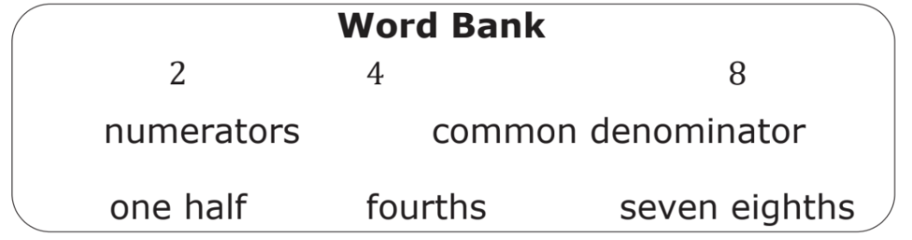
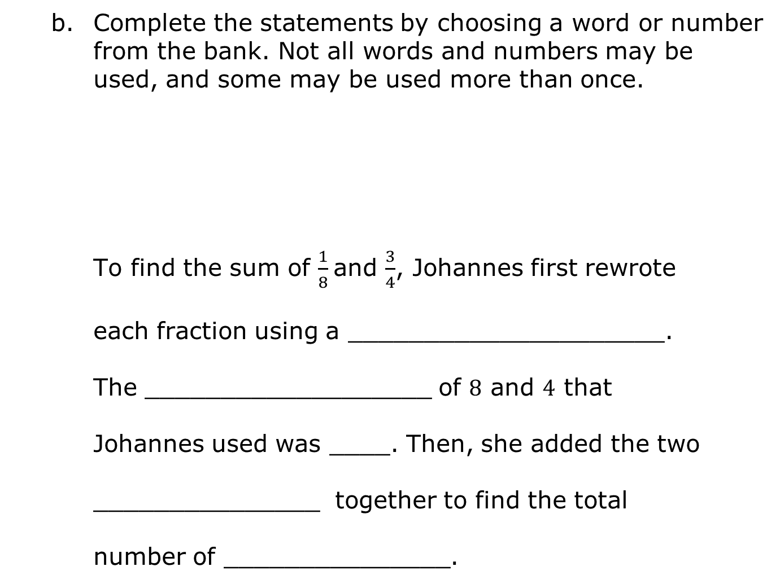
Complete the statements by choosing a word or number from the bank. Not all words and numbers may be used, and some may be used more than once.
To find the sum of $\frac{1}{8}$and $\frac{3}{4}$, Johannes first rewrote
each fraction using a _____________________.
The ___________________ of $8$ and $4$ that
Johannes used was ____. Then, she added the two
_______________ together to find the total
number of _______________.
volume 2, pg. 166

Slide 13

Try It
volume 2, pg. 167

Slide 14

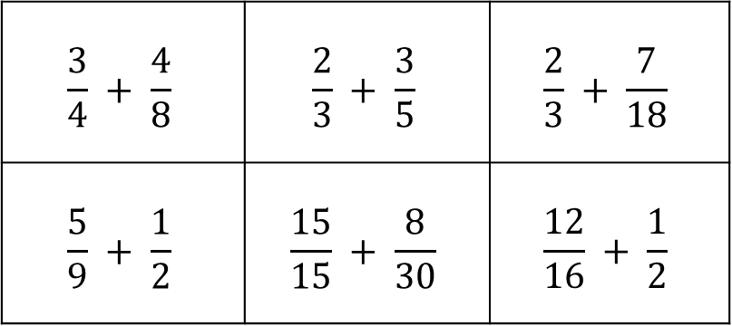
11.1.3 Try It: Adding Positive Rational Numbers
Match pairs of expressions that have the same sum. Write the equivalent expressions on the lines provided.
____________________ = ____________________
____________________ = ____________________
____________________ = ____________________
$$\frac{3}{4} + \frac{4}{8}$$ | $$\frac{2}{3} + \frac{3}{5}$$ | $$\frac{2}{3} + \frac{7}{18}$$
$$\frac{5}{9} + \frac{1}{2}$$ | $$\frac{15}{15} + \frac{8}{30}$$ | $$\frac{12}{16} + \frac{1}{2}$$
volume 2, pg. 167

Slide 15

Refresher
volume 2, pg. 167

Slide 16

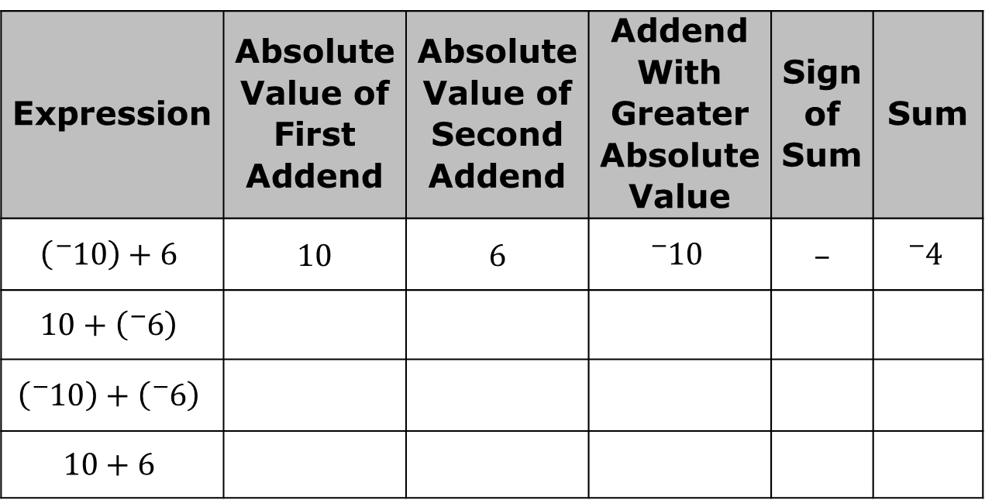
11.1.4 Refresher: Operations with Integers
Work with your partner to complete the table. The first addition expression has been done for you.
Expression | Absolute Value of First Addend | Absolute Value of Second Addend | Addend With Greater Absolute Value | Sign of Sum | Sum
$$\left({}_{ }^{−}{10}\right)+6$$ | 10 | 6 | $${}_{ }^{−}{10}$$ | – | $${}_{ }^{−}4$$
$$10+\left({}_{ }^{−}6\right)$$
$$\left({}_{ }^{−}{10}\right)+\left({}_{ }^{−}6\right)$$
$$10+6$$
volume 2, pg. 167

Slide 17
How did the size of the absolute value for each addend determine the sign of the sum?
Explain how finding the sum for the first two expressions was different from finding the sum for the last two expressions.
volume 2, pg. 167

Slide 18
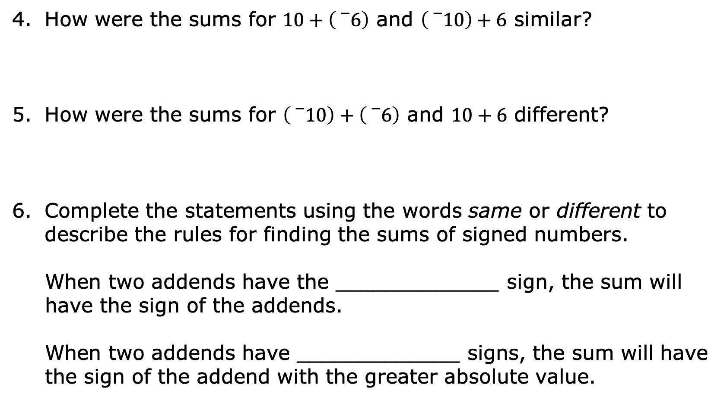
How were the sums for $10+\left({}_{}^{−}6\right)$ and $\left({}_{}^{−}{10}\right)+6$ similar?
How were the sums for $\left({}_{}^{−}{10}\right)+\left({}_{}^{−}6\right)$ and $10+6$ different?
Complete the statements using the words same or different to describe the rules for finding the sums of signed numbers.
When two addends have the _____________ sign, the sum will have the sign of the addends.
When two addends have _____________ signs, the sum will have the sign of the addend with the greater absolute value.
volume 2, pg. 168

Slide 19
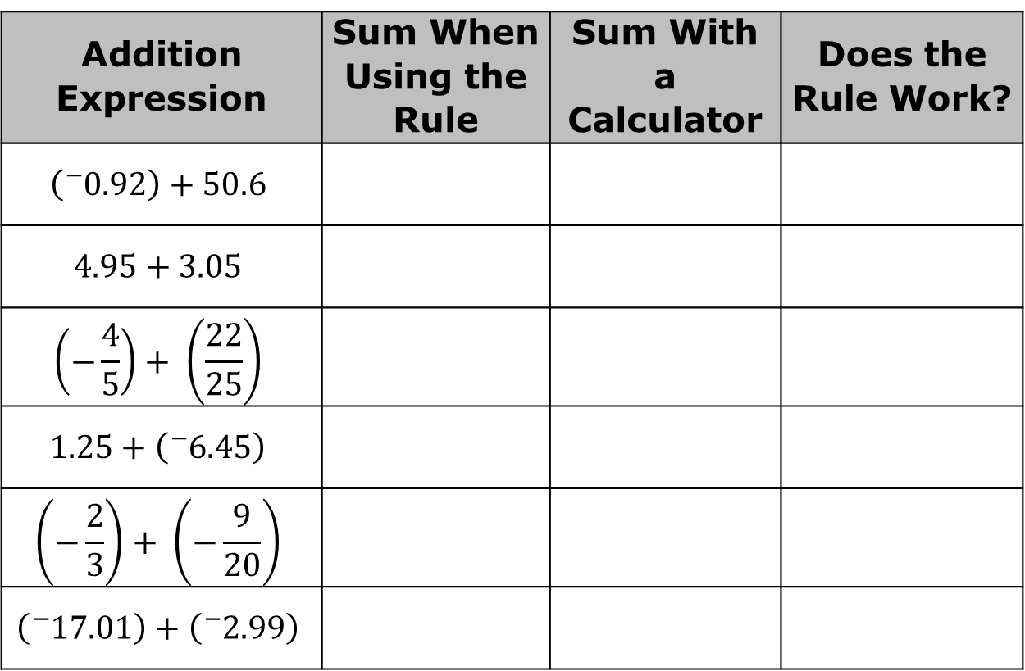
Apply the rules for integers to these expressions with rational numbers. Find the sum of each expression. Then, verify your answer using a calculator.
Addition Expression | Sum When Using the Rule | Sum With a Calculator | Does the Rule Work?
$$\left({}_{ }^{−}{0.92}\right)+50.6$$
$$4.95+3.05$$
$$\left(−\frac{4}{5}\right)+ \left(\frac{22}{25}\right)$$
$$1.25+\left({}_{ }^{−}{6.45}\right)$$
$$\left(−\frac{2}{3}\right)+ \left(−\frac{9}{20}\right)$$
$$\left({}_{ }^{−}{17.01}\right)+\left({}_{ }^{−}{2.99}\right)$$
volume 2, pg. 168

Slide 20
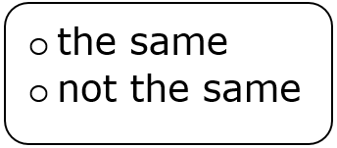
Complete the statement.
The sign rules for adding integers are as the rules for adding rational numbers.
volume 2, pg. 168

Slide 21

Guided Practice
volume 2, pg. 169

Slide 22

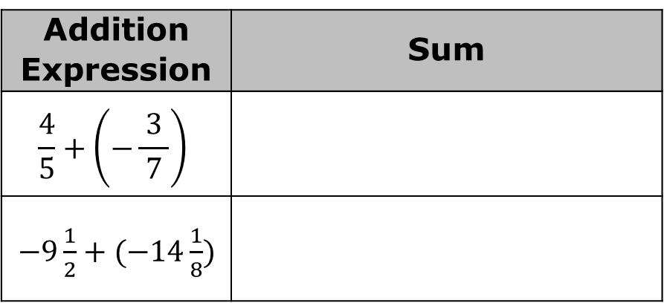
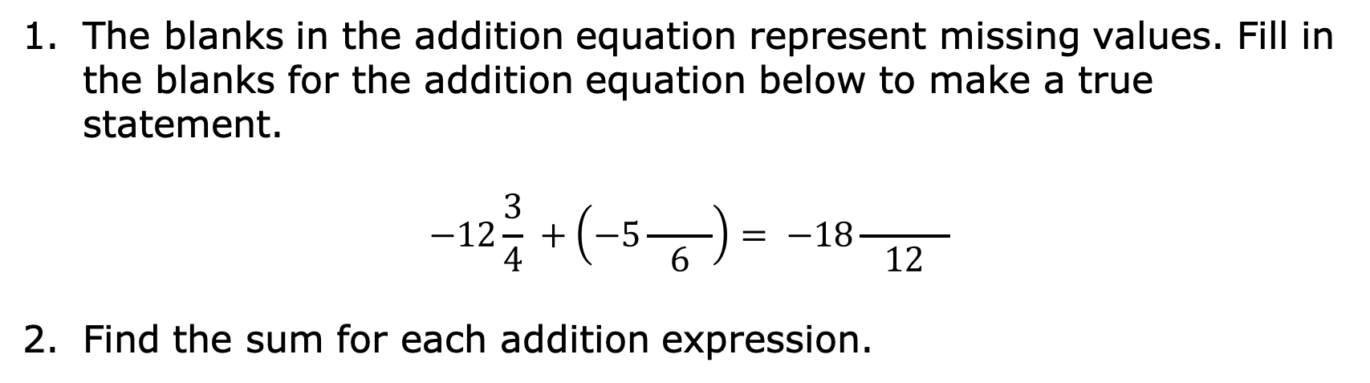
11.1.5 Guided Practice: Applying Signed Number Rules to Rational Numbers
The blanks in the addition equation represent missing values. Fill in the blanks for the addition equation below to make a true statement.
$$−12\frac{3}{4} +\left(−5\frac{ }{6}\right)= −18\frac{ }{12}$$
Find the sum for each addition expression.
Addition Expression | Sum
$$\frac{4}{5}+\left(−\frac{ 3 }{7}\right)$$
$−9\frac{1}{2}+(−14\frac{1}{8})$
volume 2, pg. 169

Slide 23
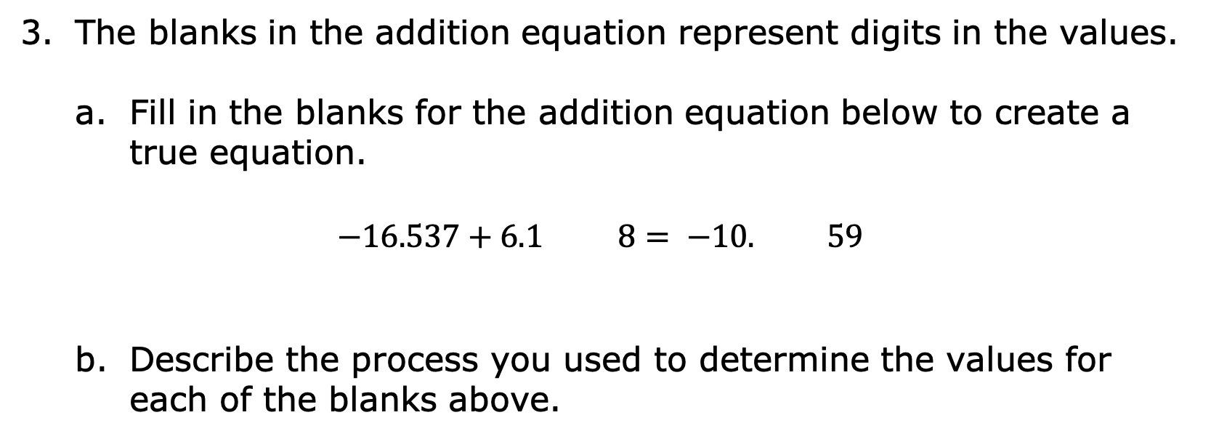
The blanks in the addition equation represent digits in the values.
Fill in the blanks for the addition equation below to create a true equation.
$$−16.537+6.1 8= −10. 59$$
Describe the process you used to determine the values for each of the blanks above.
volume 2, pg. 169

Slide 24
Discuss your process with your partner. Write a summary of their process. Have your partner initial to show that your summary accurately expressed their process.
Your Partner’s Process
Partner’s
Initials _____
volume 2, pg. 169

Slide 25

Your Turn
volume 2, pg. 170

Slide 26
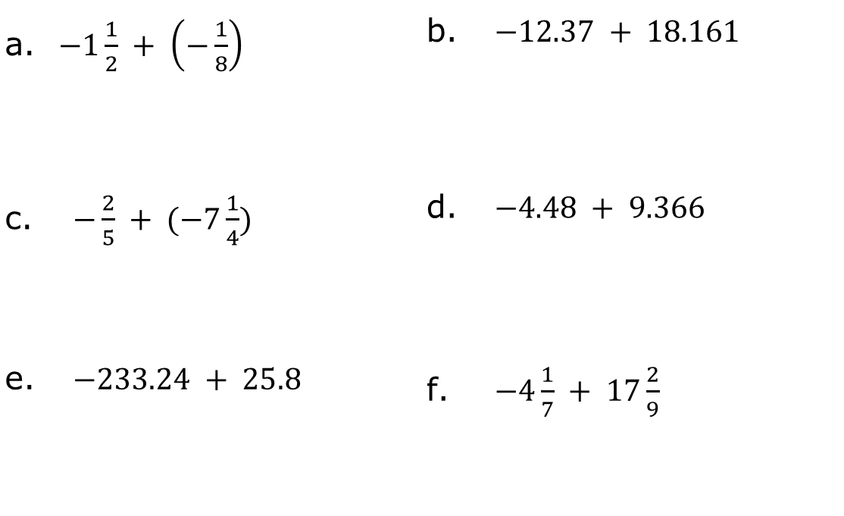
11.1.6 Your Turn!
Find the sum for each expression.
$−1\frac{1}{2} + \left(−\frac{1}{8}\right)$ | $−12.37 + 18.161$
$−\frac{2}{5} + (−7\frac{1}{4})$ | $−4.48 + 9.366$
$−233.24 + 25.8$ | $−4\frac{1}{7} + 17\frac{2}{9}$
volume 2, pg. 170

Slide 27

Wrap-Up
volume 2, pg. 170

Slide 28


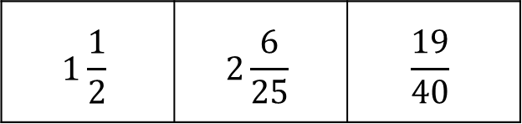
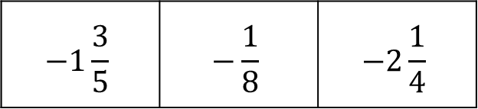
11.1.7 Wrap-Up: Ticket Out the Door
Choose a value from Row A and a value from Row B that, when added, will result in a negative answer. Then, calculate the sum.
Row A
Row B
$$−1\frac{3}{5}$$ | $$−\frac{1}{8}$$ | $$−2\frac{1}{4}$$
$$1\frac{1}{2}$$ | $$2\frac{6}{25}$$ | $$\frac{19}{40}$$
Row A |  | Row B |  | Sum
$$+$$
$$=$$
volume 2, pg. 170

